Slide 1


Modeling: Electric Circuits RLC-Circuit

Slide 2
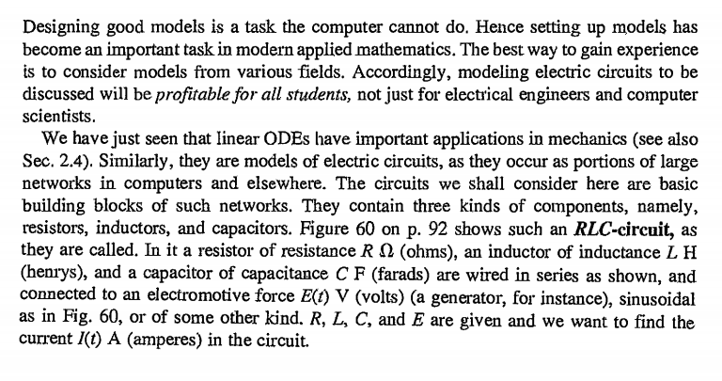
RLC-Circuit

Slide 3
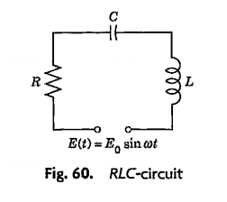

Slide 4
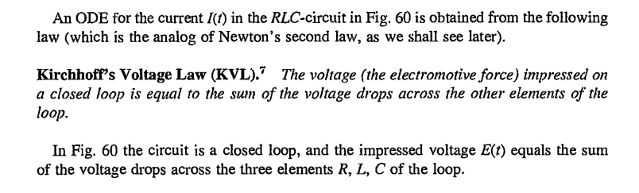
LAWS

Slide 5


Slide 6


Slide 7


Slide 8


Slide 9


Slide 10










Slide 11






















Slide 12



























Slide 13







Slide 14
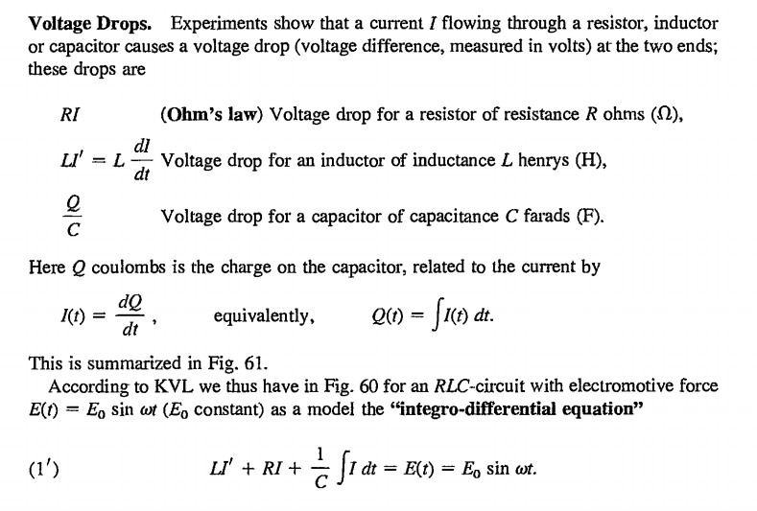

Slide 15
